Slide 1



2024W AML 2404 2 [Online 2] AI and ML Lab
Audio-Violent Threat Detection Application
Group 1
Name | Student ID | Team Role
Aanal Kamleshkumar Patel | C0910376 | Software Developer
Bimal Kumar | C0919385 | Data Scientist
Danilo Diaz | C0889539 | Solution Architect
Ernie Sumoso | C0881591 | Data Scientist
Jayachandhran Saravanan | C0910392 | Researcher and Integration Engineer

Slide 2
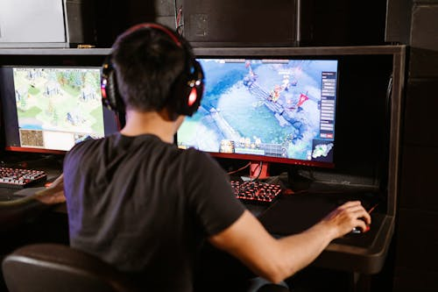

Problem statement
Vp
DATA
Pre-processing
model
Tech stack
reflection
hosting
WHAT
Threats and Harassment
Cyberbullying
Abusing and toxic comments
WHY
Non-traceable environment
Absence of live monitoring
Not enough evidence/proof
WHERE
Remote work
Gaming comms
Virtual meeting platforms
Threat detection

Slide 3



Vp
DATA
Pre-processing
model
Tech stack
reflection
hosting
WHAT STATS ARE SAYING
70%
70%
Women gamers face gender-specific discrimination
Misuse of authority in virtual meetings
Discrimination and unpleasant comments
Hard to identify and report
Targeting kids, teenagers and female players
40.9%
40.9%
Workforce in permanent or hybrid setups
36.2
billion remote work Projection by 2025 in America
36.2
Threat detection

Slide 4
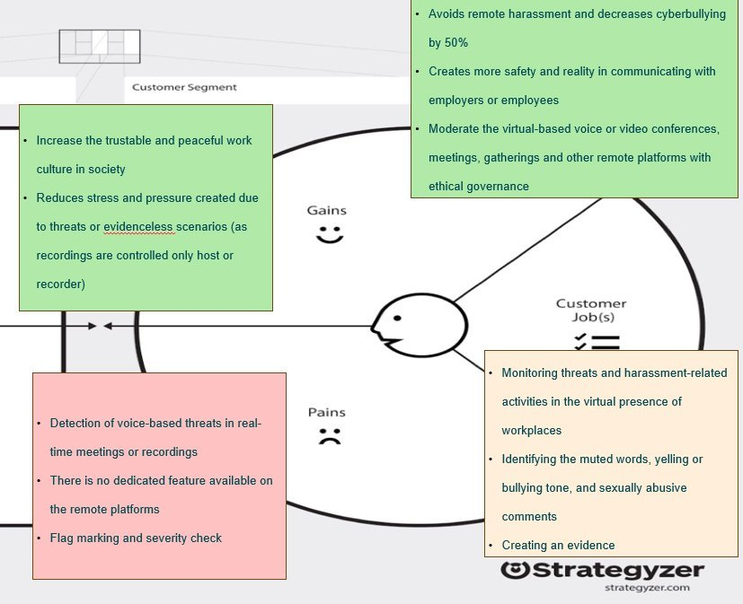

Validation
Vp
DATA
Pre-processing
model
Tech stack
reflection
hosting
Unseen challenge
RUBRIC
Threat detection

Slide 5
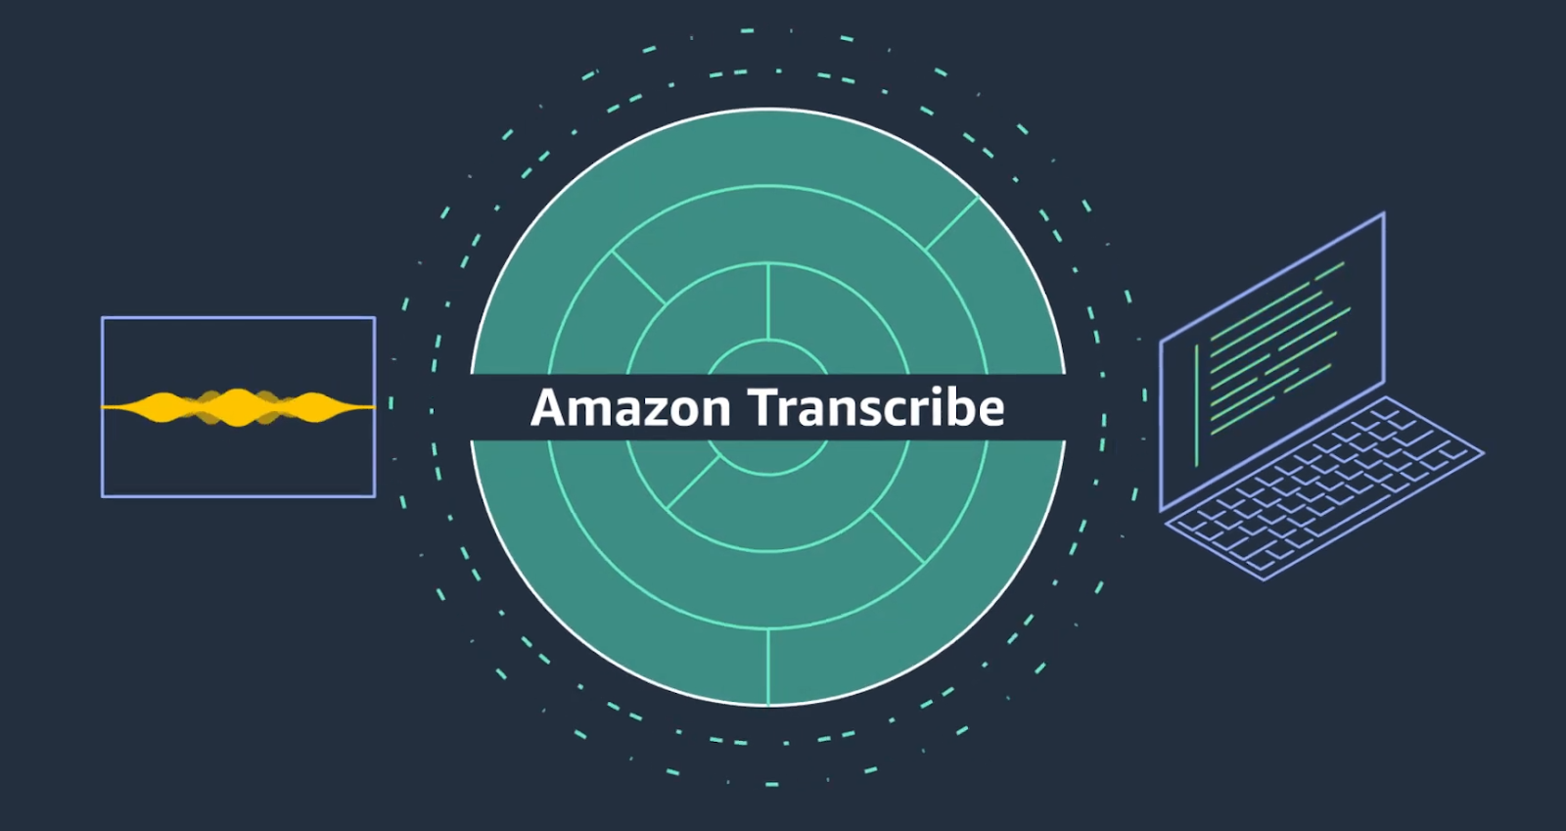
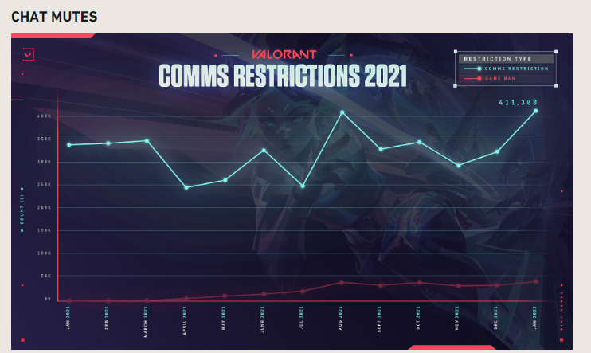
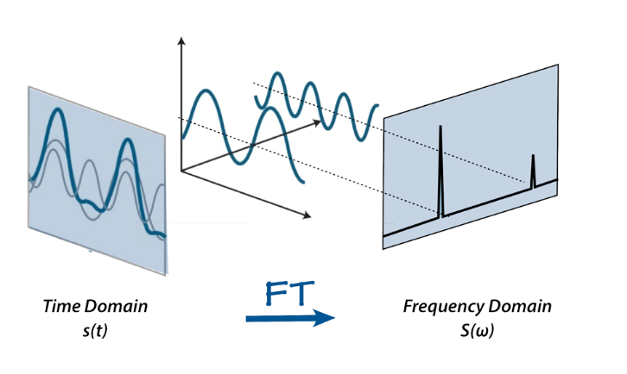
Gap analysis
Vp
DATA
Pre-processing
model
Tech stack
reflection
hosting
AWS TRANSCRIBE
VALORANT VOICE & CHAT TOXICITY
FOURIER TRANSFORM
Threat detection

Slide 6
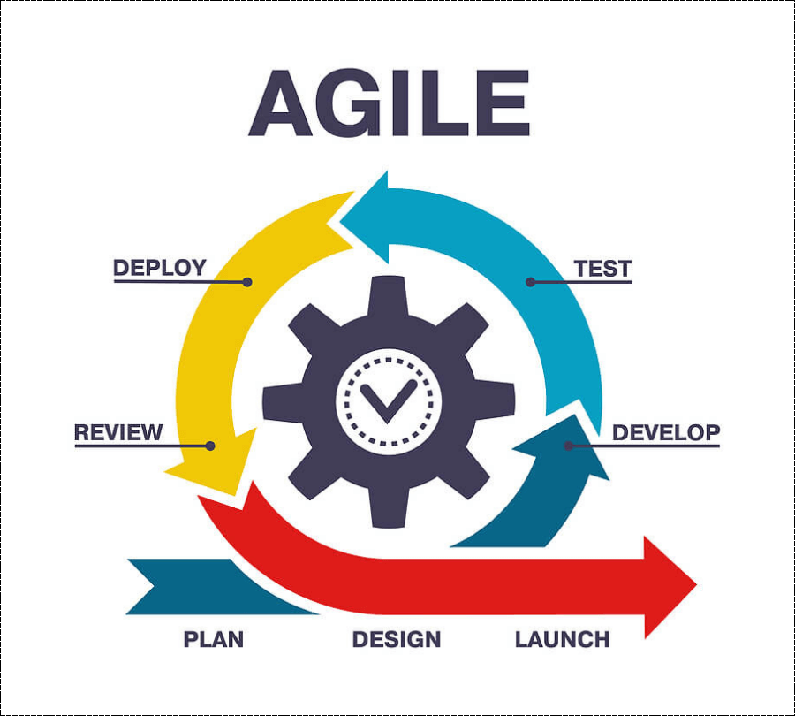
sldc
Vp
DATA
Pre-processing
model
Tech stack
reflection
hosting
Sprint based quick cycle approach
Best suitable for unique system/requirements
Collaborative and Flexible
Threat detection

Slide 7
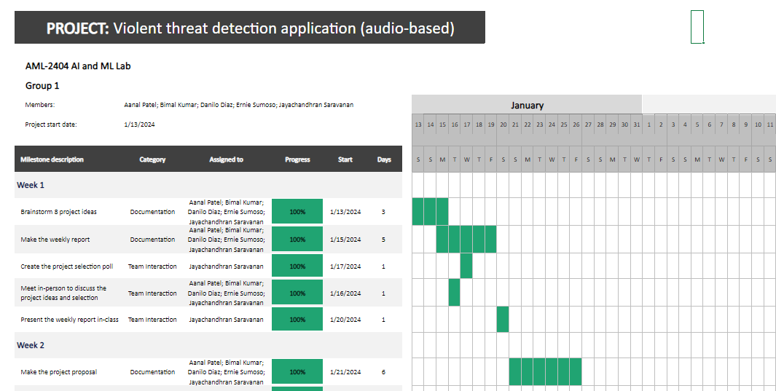
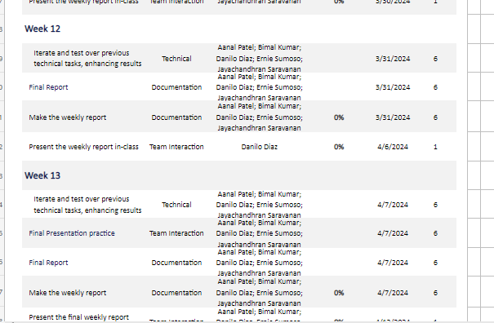
Plan – Gantt chart
Vp
DATA
Pre-processing
model
Tech stack
reflection
hosting
Threat detection

Slide 8
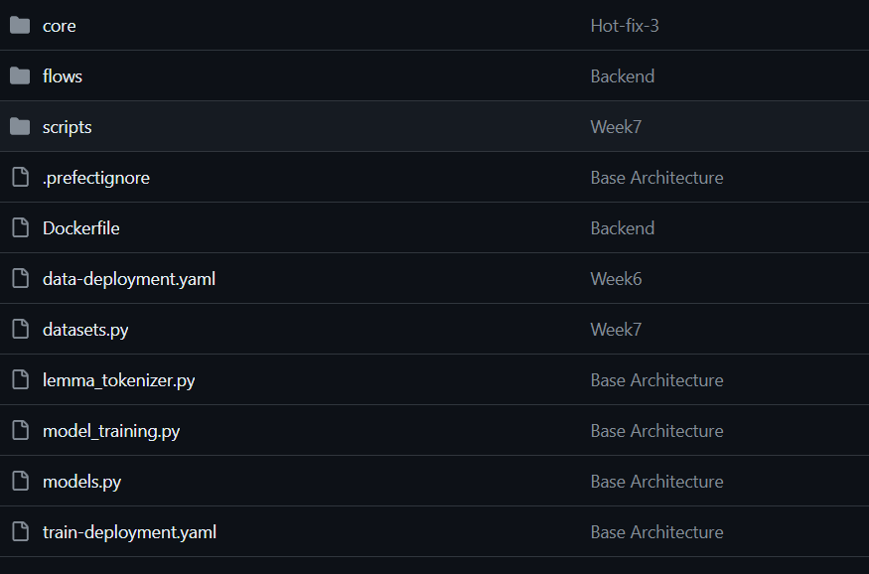

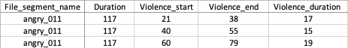
Data
Meta data
01
Audio files
02
Vp
DATA
Pre-processing
model
Tech stack
reflection
hosting
File Name
Violence start time
Violence end time
Violence Duration
custom data fetcher (refer-GitHub)
341 files
Each audio contains toxic and non toxic data
Threat detection

Slide 9
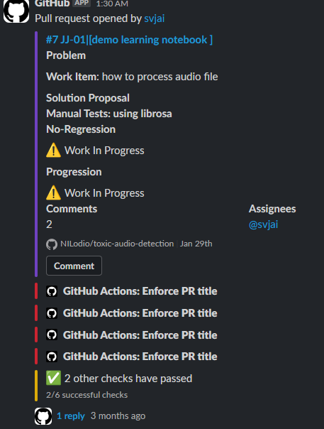
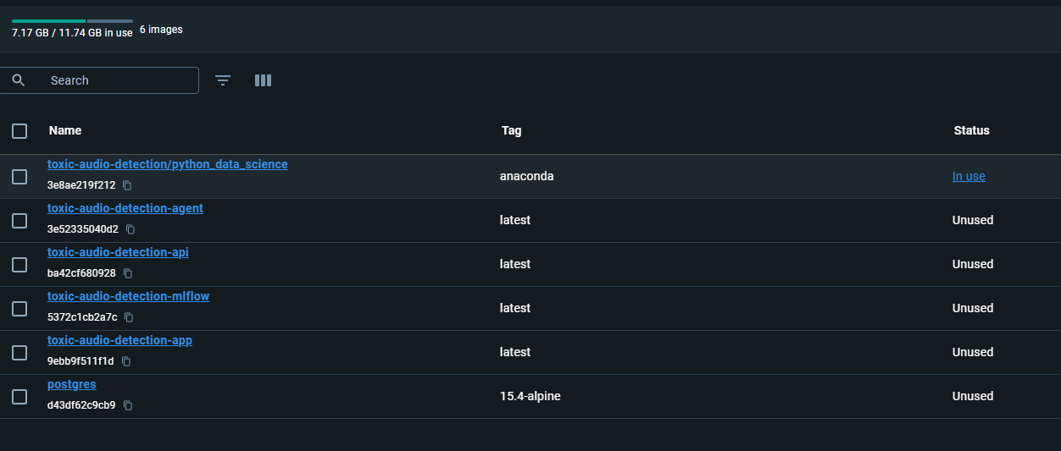
Environment setup
Vp
DATA
Pre-processing
model
Tech stack
reflection
hosting
Local machine environment
GitHub PR checkpoints
Data Fetcher
Containerization
Threat detection

Slide 10

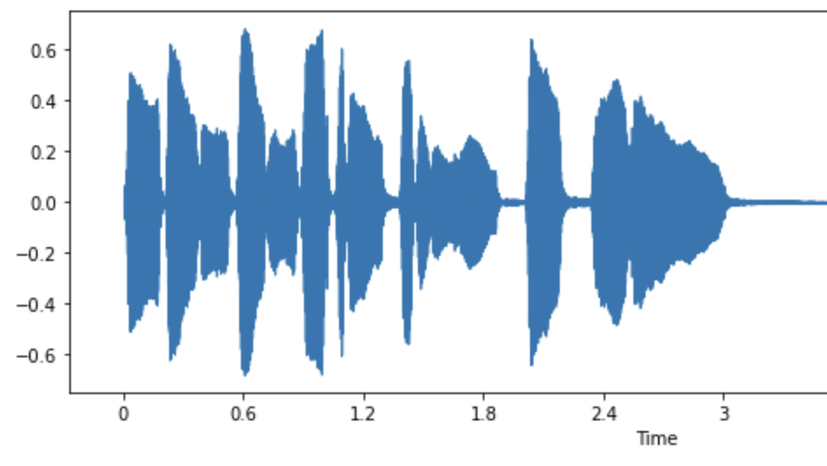
Vp
DATA
Pre-processing
model
Tech stack
reflection
hosting
How is Audio Processed ???
Audio array : array of Audio samples Dimension depends on No.
of channels
Sample Rate : Number of Audio Samples
in a second
Threat detection

Slide 11
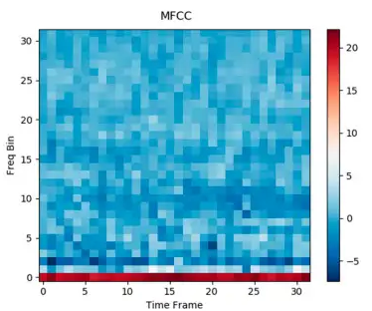
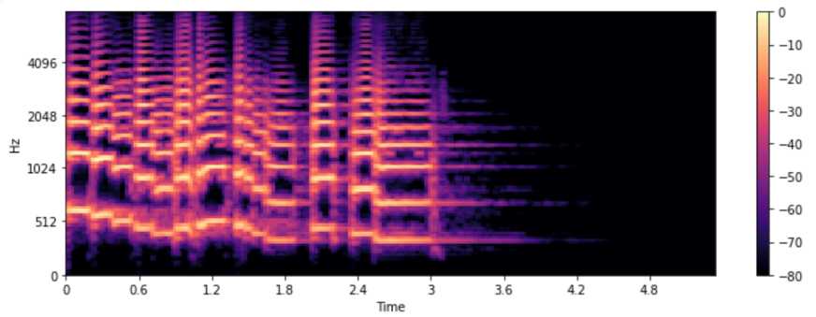
Vp
DATA
Pre-processing
model
Tech stack
reflection
hosting
MEL Spectrogram
Spectrogram plots frequency distribution over time.
Heatmap of amplitude
Spectrogram Mel Spectrogram
Human Ear sensitive to lower frequencies
Pictorial Feature
Threat detection

Slide 12

Vp
DATA
Pre-processing
model
Tech stack
reflection
hosting
Preprocess Pipeline
Librosa works best with wav files
Volume Normalization to reduce bias
Threat detection

Slide 13
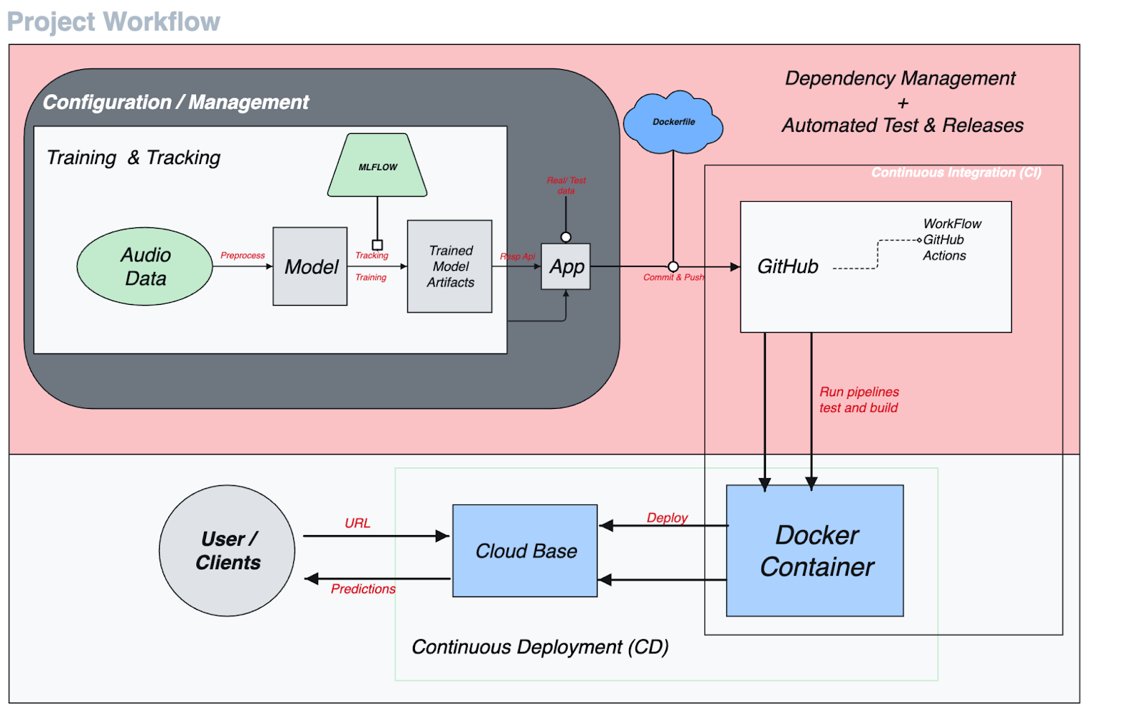
Vp
DATA
Pre-processing
model
Tech stack
reflection
hosting
Base Architecture
Threat detection

Slide 14
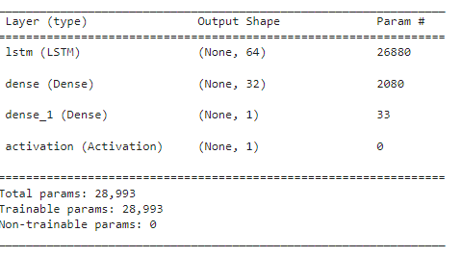
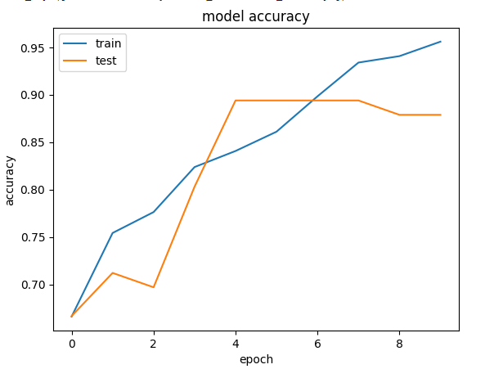
Vp
DATA
Pre-processing
model
Tech stack
reflection
hosting
Model
Threat detection

Slide 15
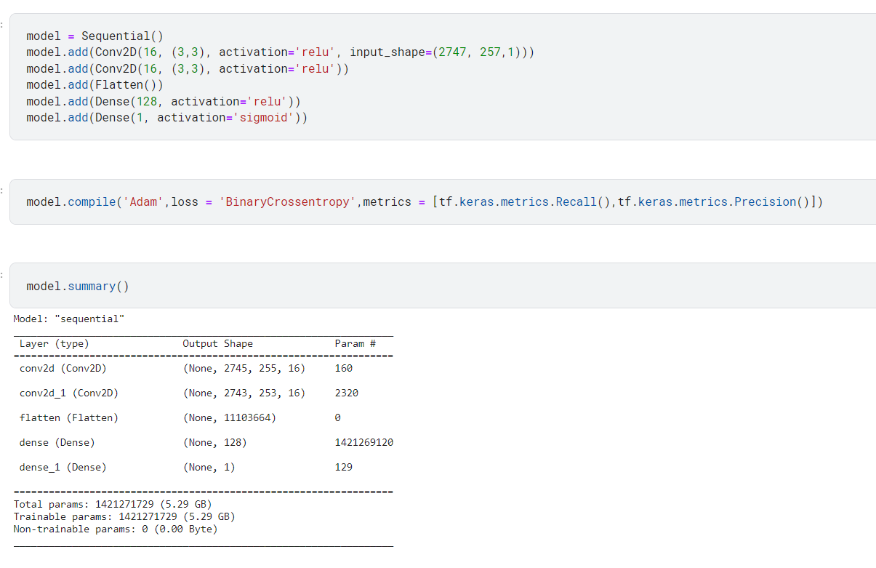
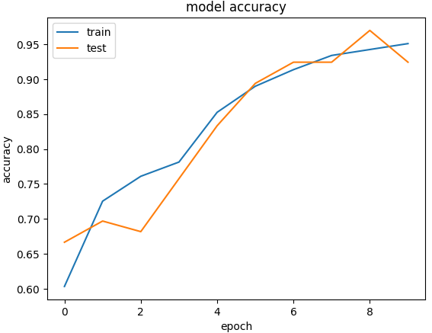
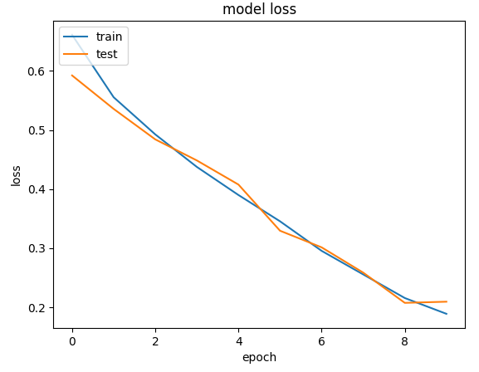
Vp
DATA
Pre-processing
model
Tech stack
reflection
hosting
Tuning and improvements
Threat detection

Slide 16

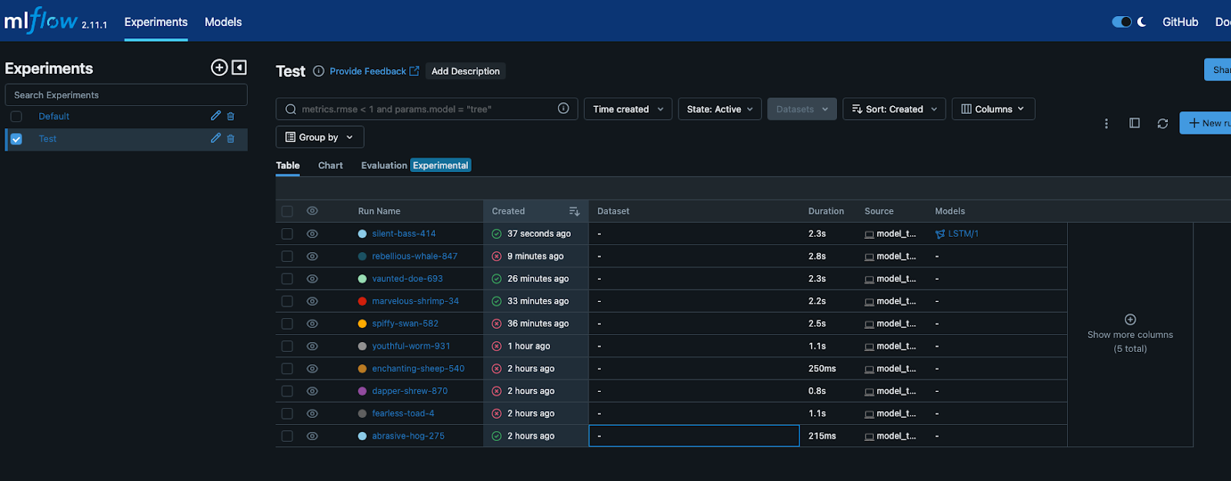
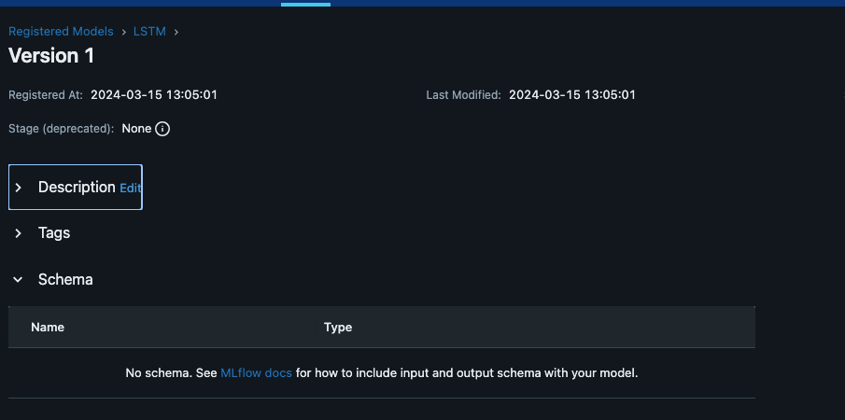
Vp
DATA
Pre-processing
model
Tech stack
reflection
hosting
Real-time execution workflow
Automatic Model saving in MLflow for compressive model iteration tracking
Creating multiple version for effective management
Easy access and version control for model
Threat detection

Slide 17
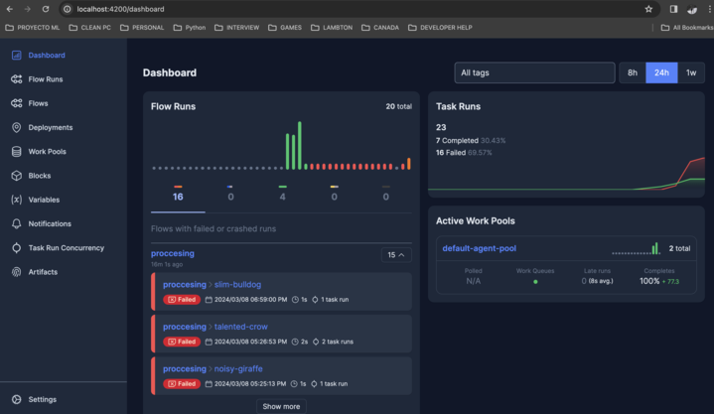
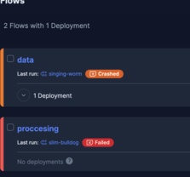
Vp
DATA
Pre-processing
model
Tech stack
reflection
hosting
Other Workflow Orchestration
PyDub library – Data segmentation
Automated pipeline
Fetching data
Data preparation
Threat detection

Slide 18
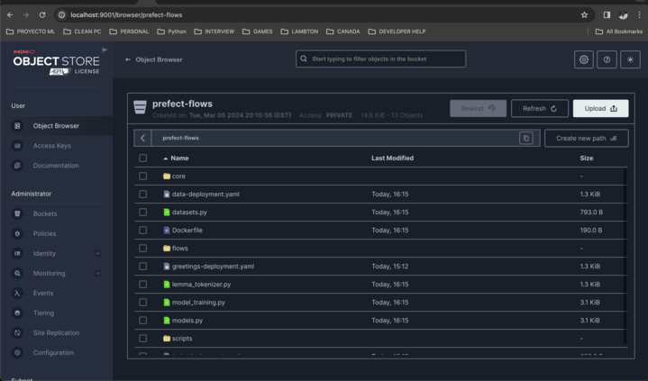
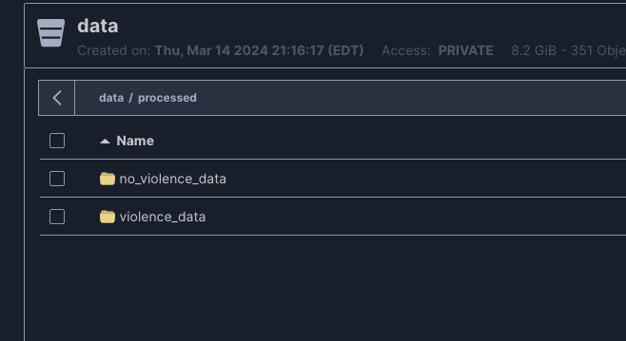
Vp
DATA
Pre-processing
model
Tech stack
reflection
hosting
Minio (storage bucket)
Load and format raw data
Resolves data fetcher conflict
Prefect logs and support data are
stored as well
Threat detection

Slide 19
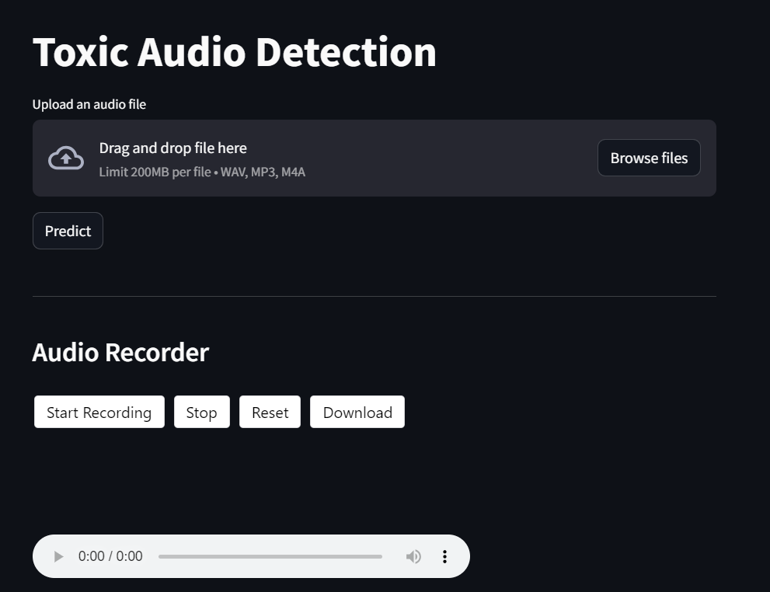


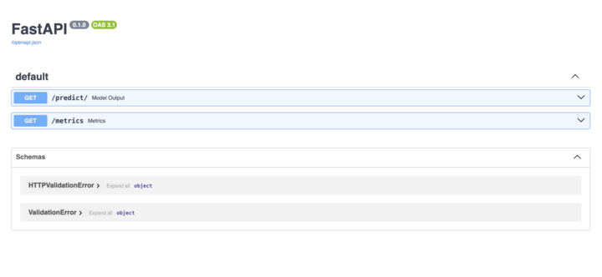


Vp
DATA
Pre-processing
model
Tech stack
reflection
hosting
User interface
Frontend
Implementing Simple UI for uploading the audio file or recording the live audio
Backend
Integration of backend API for calling the train model's interface engine.
Threat detection

Slide 20
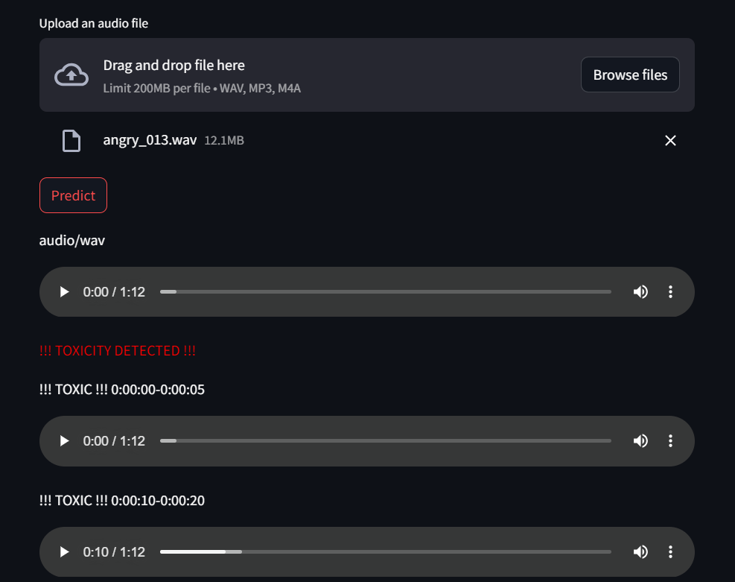
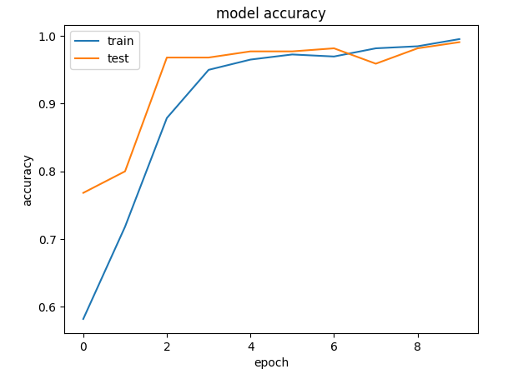
Vp
DATA
Pre-processing
model
Tech stack
reflection
hosting
Testing local Deployment
Train-Accuracy: 0.96
Test-accuracy: 0.92
Threat detection

Slide 21
Vp
DATA
Pre-processing
model
Tech stack
reflection
hosting
updated Architecture
Threat detection

Slide 22


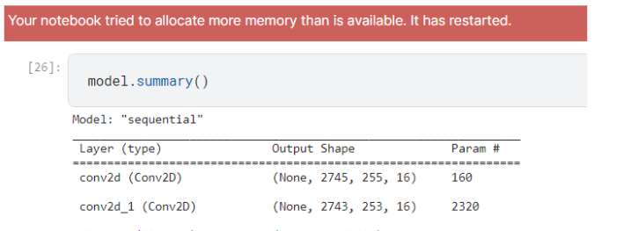

challenges
Vp
DATA
Pre-processing
model
Tech stack
reflection
hosting
Data quality
Domain knowledge
File/os compatibility
Computational power
Threat detection

Slide 23
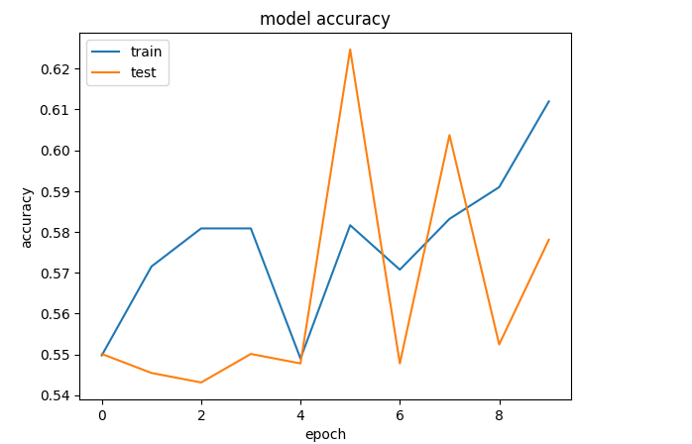


Vp
DATA
Pre-processing
model
Tech stack
reflection
hosting
Model instability
high Training duration
Inconsistent audio format
Threat detection

Slide 24

Learning outcome
Vp
DATA
Pre-processing
model
Tech stack
reflection
hosting
Unit test and user experience testing
Following standard coding practices
Reviewing edge case tests
Reproducible code functions
Handling audio data and nitty-gritty of processing
File format conversation (near real world)
Machine learning operations
Track model parameters
Metrics and log analysis
Threat detection

Slide 25
Features
Vp
DATA
Pre-processing
model
Tech stack
reflection
hosting
benefits
Live audio recording
Recorder audio
Artifacts and analysis logs
Computation estimation
Audio evaluation (customer center)
Evidence and easy cue analysis
Automation of tedious listening processes
Safety and ethical governance
Moderate virtual platforms
Threat detection

Slide 26
Future scope
Vp
DATA
Pre-processing
model
Tech stack
reflection
hosting
Live stream
Classifying toxicity category
Severity score
Processing live audio (stream) data
Sorting toxicity into dedicated 8 types
Return predicted toxic value
Comparison and piloting
Light-weight and deployment
Publication
Running a pilot version and evaluate
Smooth and easy processing on user application
Document and publish the work
Threat detection

Slide 27

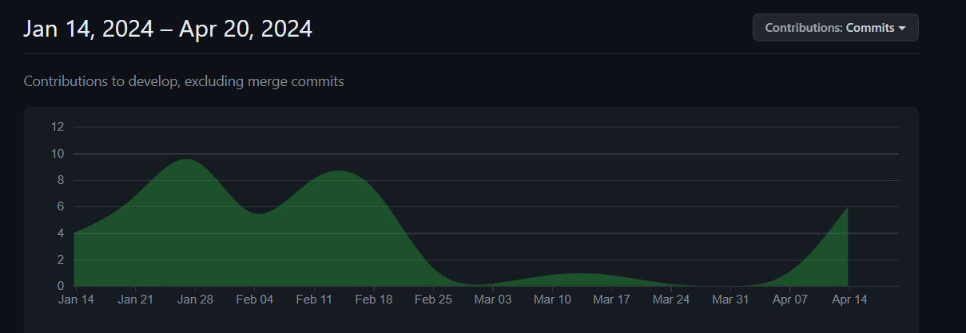
GitHub and weekly progress
Vp
DATA
Pre-processing
model
Tech stack
reflection
hosting
WEEK(S) | ACHIEVED MILESTONE
1-4 | Ground study/research Data procuring Analysis
5-8 | Arch development Base model Conflict and issue identification
9-12 | Fine tuning model Orchestration and optimization Integration and testing
13-14 | Deployment Bug fix Documentation
Threat detection

Slide 28
Hosting and demo
Vp
DATA
Pre-processing
model
Tech stack
reflection
hosting
https://toxic-audio-detection.streamlit.app
Threat detection

Slide 29
rEFERENCES
https://slidesgo.com/faqs
Hugging Face - https://huggingface.co/learn/audio-course/chapter1/audio_data
MLFlow | MLFlow. (n.d.). https://mlflow.org/
FastAPI. (n.d.). https://fastapi.tiangolo.com/
Prefect | Modern Workflow Orchestration. (n.d.). https://docs.prefect.io/latest/tutorial/
Streamlite • A faster way to build and share data apps. (n.d.). https://streamlit.io/
Bird, J. J. (2023, August 24). Real-time detection of AI-Generated speech for DeepFake voice conversion. arXiv.org. https://arxiv.org/abs/2308.12734
Yan, J. (2023, July 27). Detection of Children Abuse by Voice and Audio Classification by Short-Time Fourier Transform Machine Learning implemented on Nvidia Edge GPU device. arXiv.org. https://arxiv.org/abs/2307.15101
How we can tackle toxicity to create more inclusive gaming. (2024, January 25). World Economic Forum. https://www.weforum.org/agenda/2024/01/inclusive-gaming-tackling-toxicity/#:~:text=Reach3%20Insights%2C%20a%20market%20research,for%20players%20and%20the%20industry.
Haan, K. (2023, June 12). Remote Work Statistics and Trends in 2024. Forbes Advisor. https://www.forbes.com/advisor/business/remote-work-statistics/
https://mlsdev.com/blog/agile-sdlc
https://yuktisolutions.com/blog/agile-sdlc-for-your-project
https://streamlit.io/

Slide 30
THANKS!

